Slide 1

SOLAR TRACKER WITH AUTOMATIC CLEANING
Submitted By:
Fatima Choudhary (SP26-BCS-012)
Fatima Mazhar (SP26-BCS-013)
Laiba Mudassar (SP26-BCS-021)
Alia Sajid (SP26-BCS-056)
Suriya Sultan (SP26-BCS-044)
Munaza Sadiq(SP26-BCS-036)
Submitted TO: MAM IFRAH MATEEN
Course: Applied PhysicS
COMSATS University Islamabad
Vehari Campus | Department of Computer Science
Date: May 19, 2026
This Photo by Unknown Author is licensed under CC BY-SA

Slide 2
INTRODUCTION :
"Solar energy is one of the best renewable power sources available, but solar panels lose a lot of their efficiency if they are covered in dust or are not directly facing the sun. To solve this problem, this project introduces a Solar Tracker with an Automatic Cleaning System. Using an Arduino as the main controller, the system automatically rotates the solar panel to follow the sun's path throughout the day to capture maximum light. Additionally, it automatically cleans dust off the panel, ensuring it always produces the highest possible amount of electricity with zero manual effort."

Slide 3
List of Required Components :
Arduino Nano
Breadboard
Relay Module
DC Motor
Lithium-ion Battery
DC-DC Boost Converter Module
Jumper Wires
Resistors
Capacitors
Transistor
Light Dependent Resistors (LDRs) (Required for the tracking mechanism)

Slide 4
Working Principle of the System
Solar Tracking Mechanism (Light Response)
The solar tracking feature ensures that the solar panel always faces the sun to generate the maximum possible power. This is achieved using light sensors, typically Light Dependent Resistors (LDRs).
The LDRs are placed on opposite sides of the solar panel.
When a light source (like the sun or a flashlight during testing) shines on the setup, the LDR facing the light receives higher intensity than the other, causing its electrical resistance to drop.
This creates a voltage difference that the control system detects. The system then activates a motor to tilt or rotate the panel toward the stronger light until the light hitting both LDRs is equal. This allows the panel to actively "follow" the light source throughout the day.

Slide 5
Automatic Cleaning System (Arduino Controlled)
The Arduino Nano serves as the central brain for the automatic cleaning system, ensuring the panel remains free of dust, which would otherwise block light and reduce efficiency.
Power Management: The 3.7V Lithium-ion battery provides the main power. Because the Arduino and the relay need exactly 5V to work properly, the DC-DC Boost Converter steps the battery voltage up to a stable 5V.
Triggering the Cycle: The Arduino is programmed to initiate a cleaning cycle at specific intervals (using a timer code) or when it detects a massive drop in power output.
Actuating the Motor: When it is time to clean, the Arduino sends a low-power digital signal to the Transistor. The transistor acts as a switch that activates the Relay Module.
The Cleaning Action: The relay bridges the connection, allowing higher current to flow directly to the DC Motor without damaging the Arduino. The motor powers a wiper or brush that sweeps across the solar panel to remove dust. Once the programmed cleaning time finishes, the Arduino stops the signal, the relay turns off, and the motor stops.

Slide 6
Arduino:
Arduino is an open-source electronics platform based on easy-to-use hardware and software. It consists of a physical programmable circuit board (a microcontroller) and a software interface (IDE) used to write and upload code to the board. In any automation project, the Arduino acts as the "brain"—it reads physical inputs (like light on a sensor ) and processes them to generate a specific physical output (like turning on a motor ).
How Arduino is Related to Physics
The operation of an Arduino is deeply rooted in the principles of Applied Physics. It bridges the gap between theoretical physics and practical engineering in the following ways:
1.Solid-State Physics and Semiconductors:
The core of the Arduino (its microcontroller chip) is made entirely of microscopic transistors built from silicon, which is a semiconductor material. The way this chip processes information— electrons to represent binary data (0s and 1s)—is a direct application of solid-state physics.

Slide 7
Electricity & Circuits (Ohm’s Law):
Arduino controls the flow of voltage and current (V = IR)to power project's components safely without burning them out.
Light Physics (Photoelectric Effect):
When the Arduino uses light sensors (LDRs) to track the sun, it relies on physics: light energy hitting the sensor physically changes its electrical resistance.
Motion (Electromagnetism):
When the Arduino turns on the DC motor for cleaning, it uses electricity to create a magnetic field inside the motor.
This magnetic field creates the physical movement that spins the wiper.

Slide 8
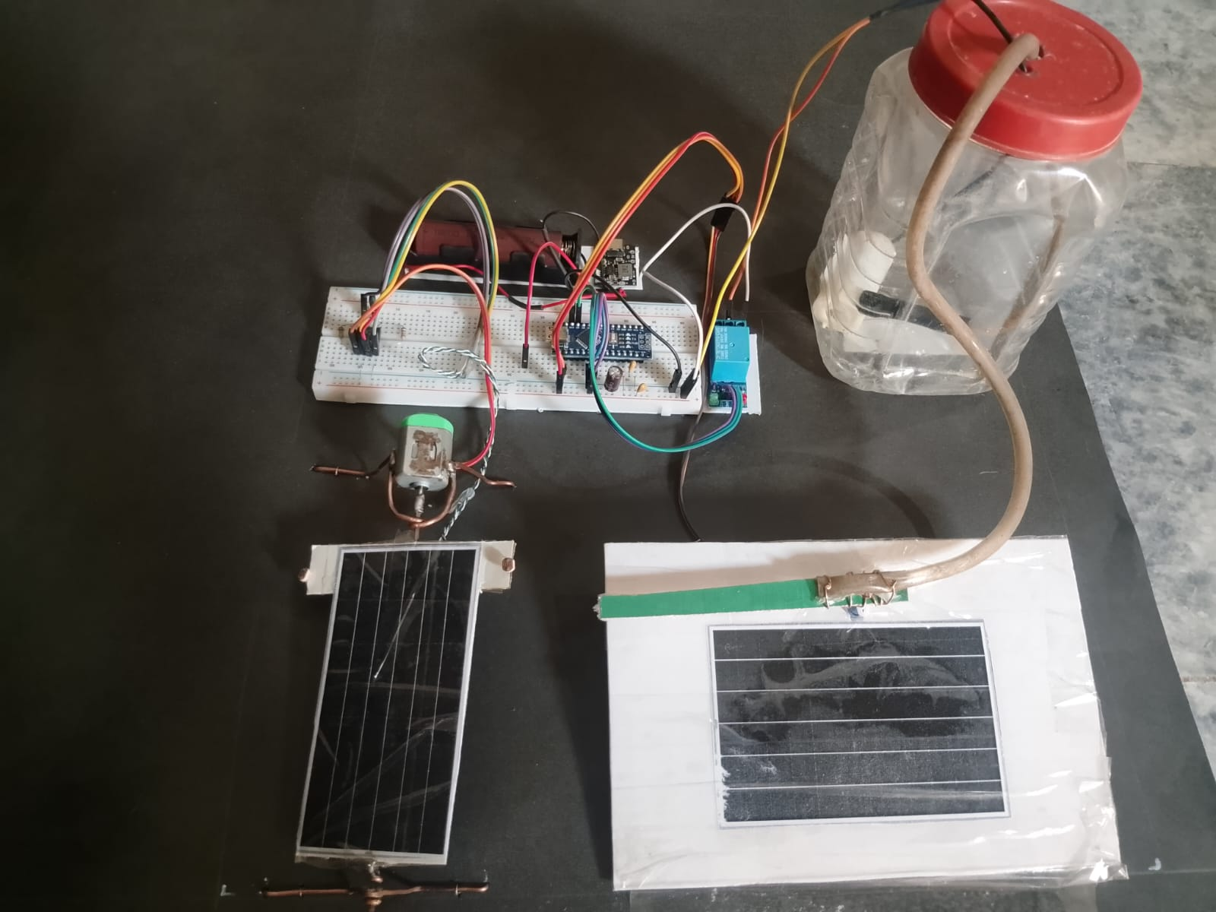

Slide 9
